Slide 1

Search for an exotic Higgs boson decay to two pseudoscalar bosons with a four photon final state Oral Candidacy Proposal December 13, 2023
Sergi Castells
Advisors: Colin Jessop and Nancy Marinelli

Slide 2
The Standard Model and Beyond
LHC and CMS
Introduction to Analysis
Sample Generation
Event Selection
Signal Modelling
Advancements on Previous Studies
Summary
Notes:
Introduction – what am I doing? Basic why is it interesting?
The Standard Model and Beyond – theory stuff
LHC and CMS – also mention service work here briefly
Sample Generation – signal MC and event mixing part
Event Selection – cuts, BDT, categorization
Signal Modelling – signal modelling + note on background fits
Advancements on Previous Studies – exactly what it sounds like
Summary – put everything together for questions
REMEMBER TO INCLUDE PLOTS!!!!!!!

Slide 3
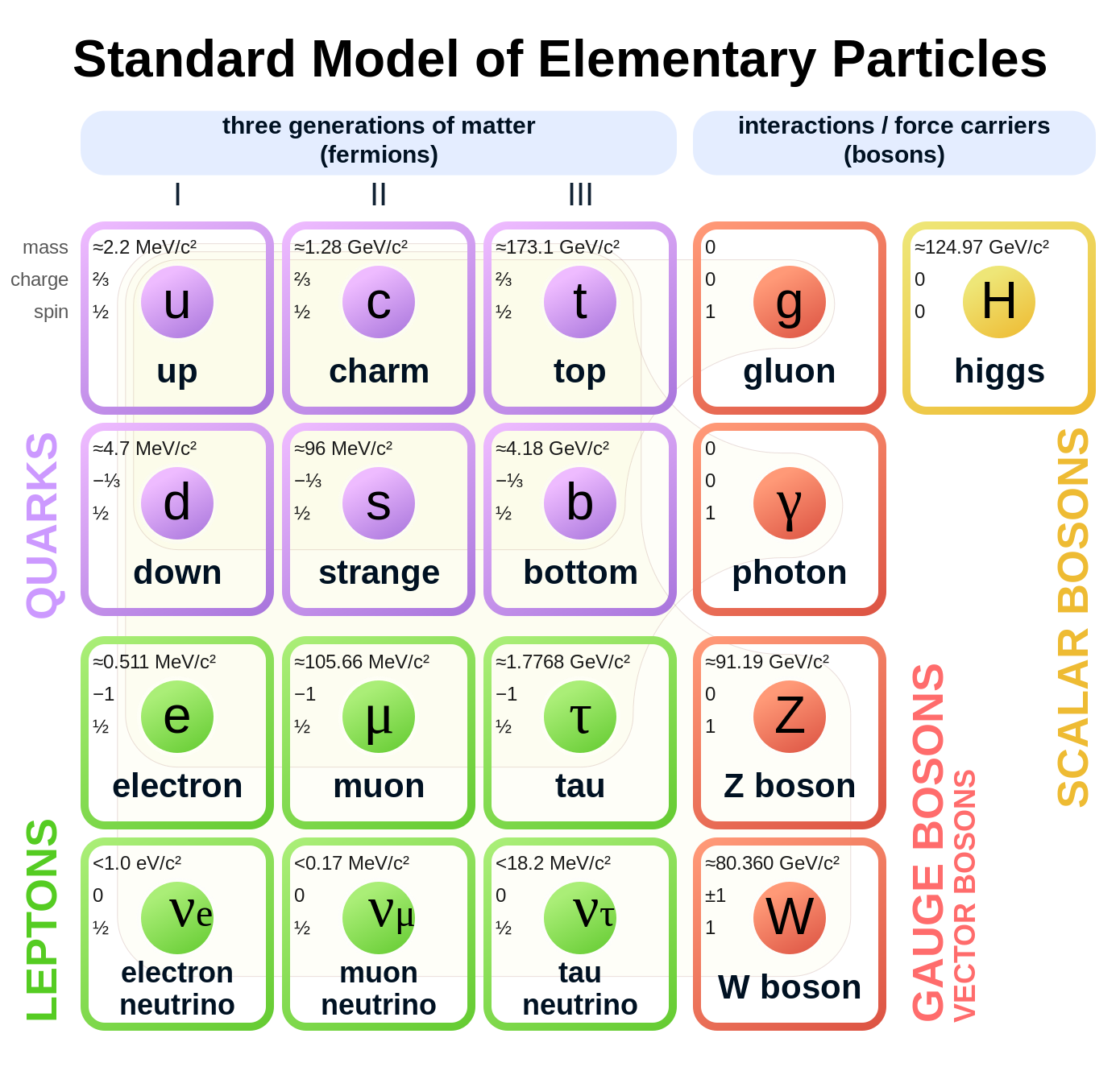
The Standard Model and Beyond
Most complete model of particle physics that describes all known elementary particles.
Describes three fundamental interactions:
Weak
Strong
Electromagnetic
Rich Higgs sector phenomenology:
Higgs mechanism yields gauge boson masses
Higgs VEV & Yukawa couplings yield other particle masses
Beyond the Standard Model physics can remedy its shortcomings and predict interesting, new physics.

Slide 4
The Standard Model and Beyond
LHC and CMS
Introduction to Analysis
Sample Generation
Event Selection
Signal Modelling
Advancements on Previous Studies
Summary
Notes:
Introduction – what am I doing? Basic why is it interesting?
The Standard Model and Beyond – theory stuff
LHC and CMS – also mention service work here briefly
Sample Generation – signal MC and event mixing part
Event Selection – cuts, BDT, categorization
Signal Modelling – signal modelling + note on background fits
Advancements on Previous Studies – exactly what it sounds like
Summary – put everything together for questions
REMEMBER TO INCLUDE PLOTS!!!!!!!

Slide 5
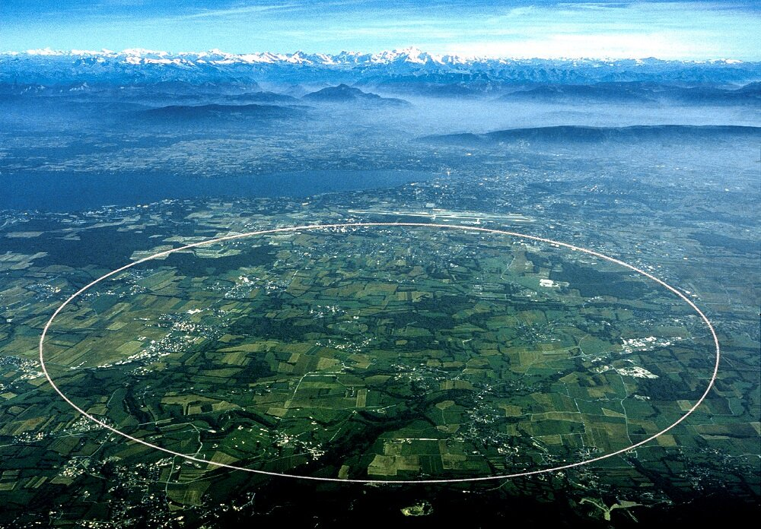
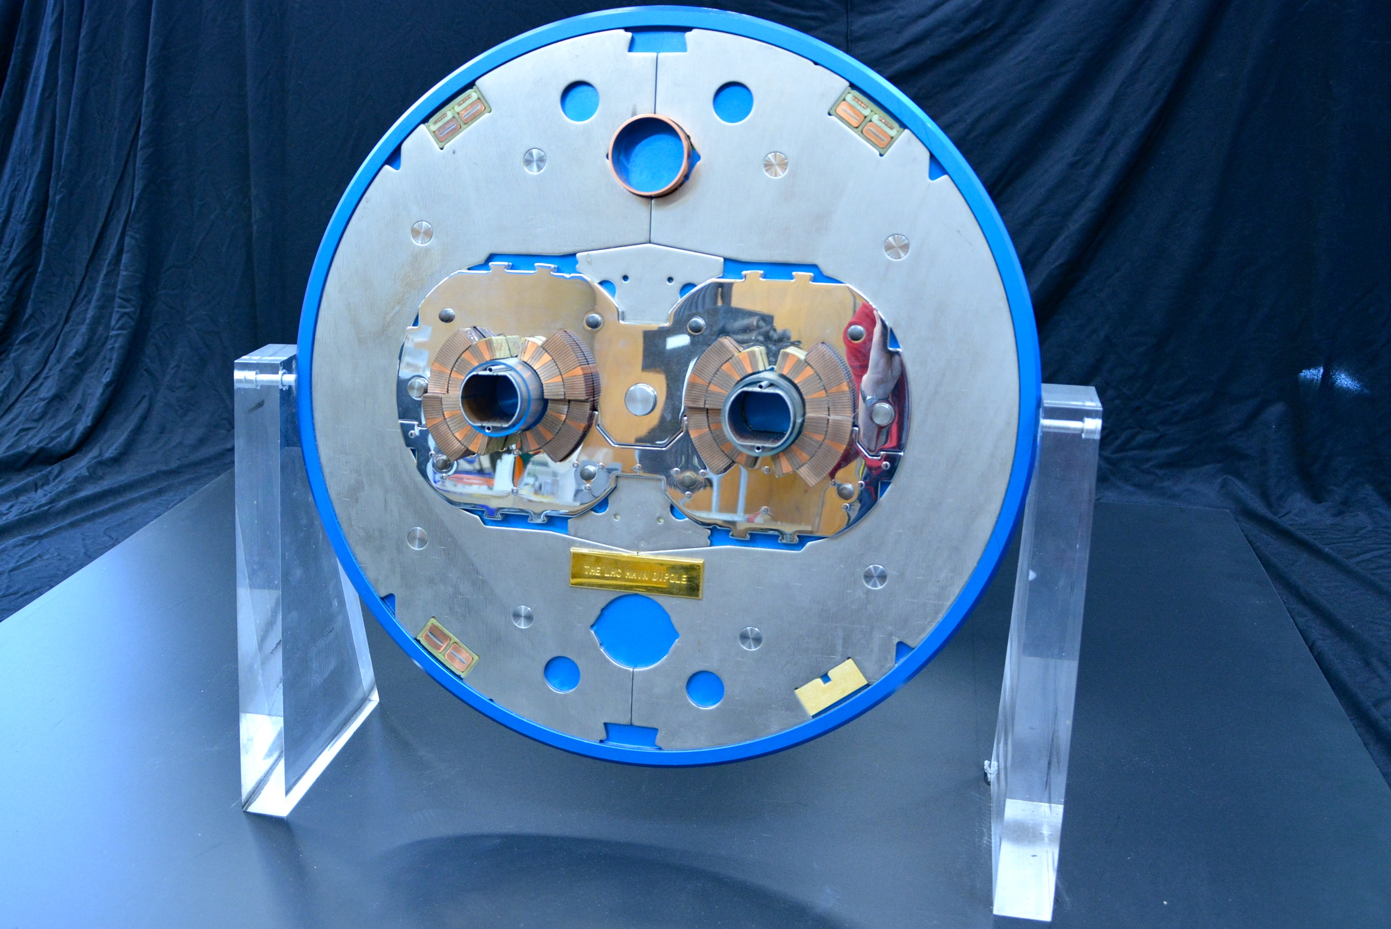
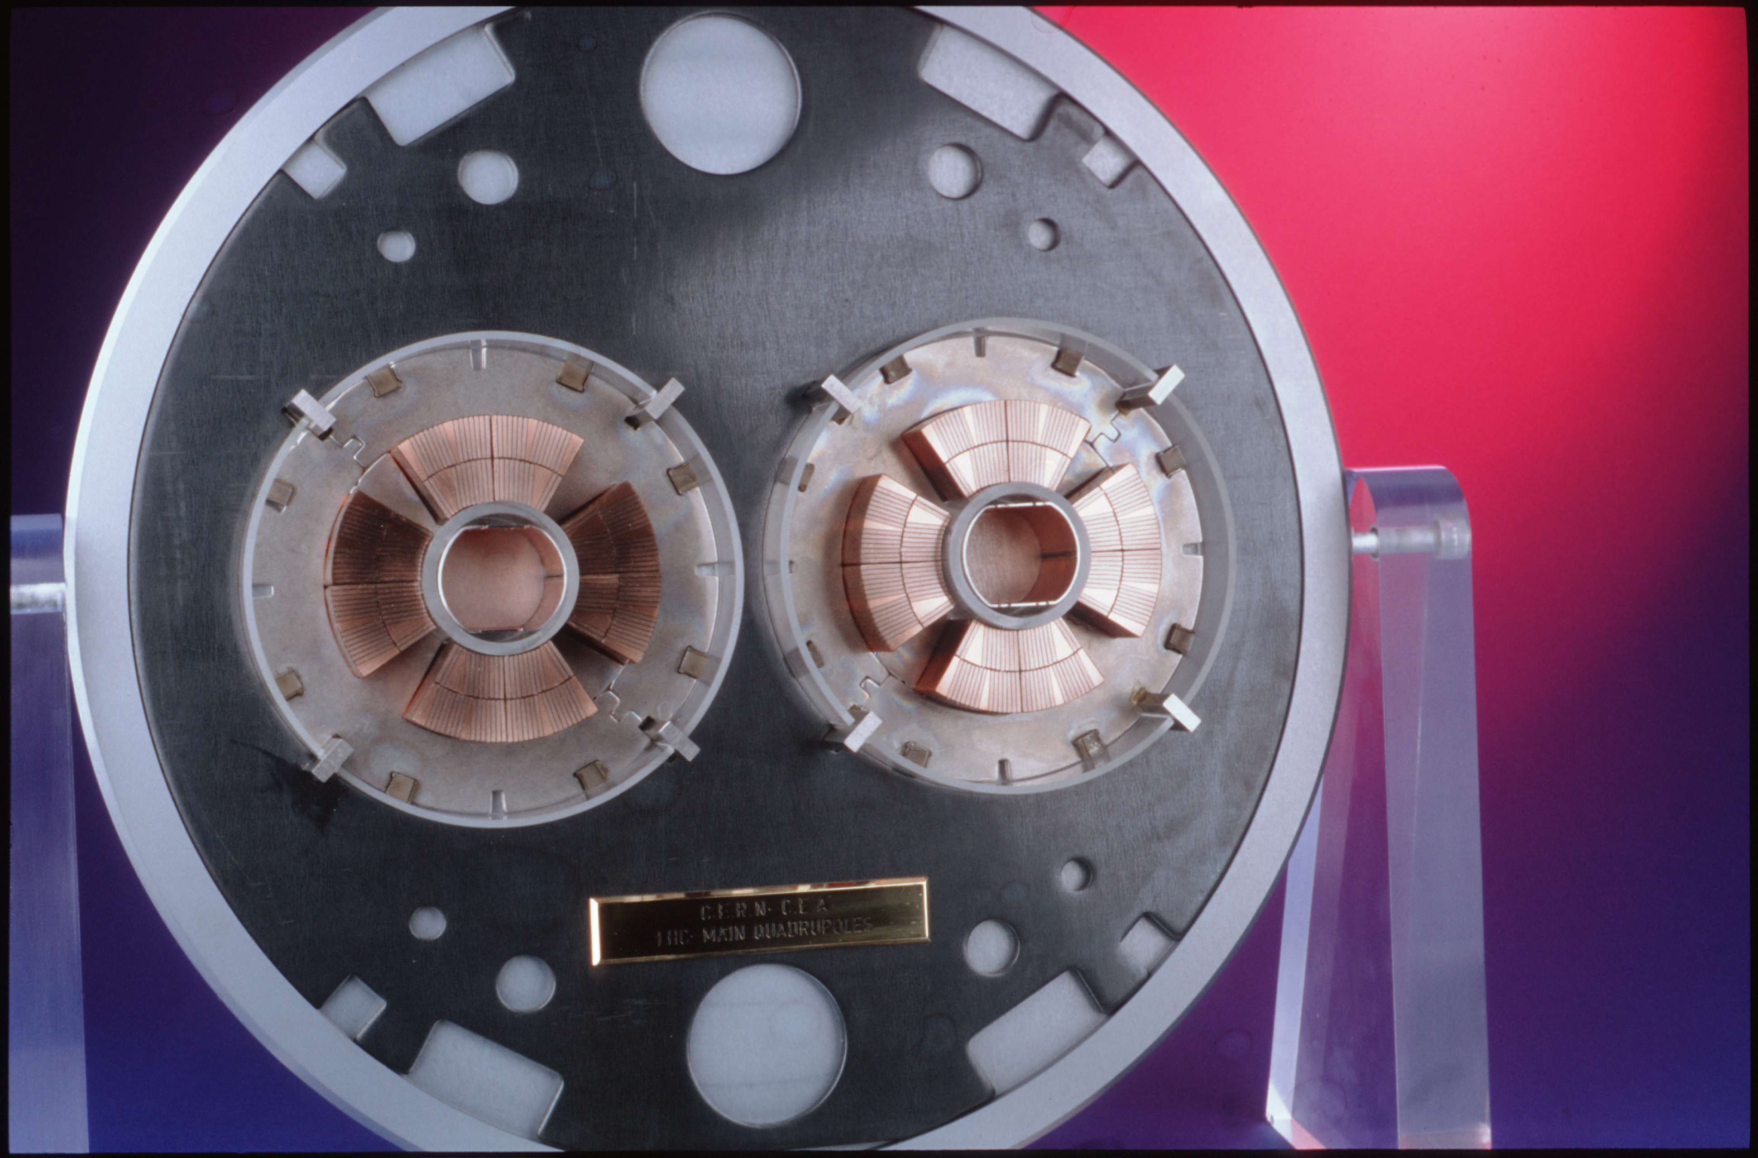
The Large Hadron Collider (LHC)
The LHC is the world’s largest particle accelerator, located on the border of France and Switzerland.
It is 27 km in circumference and operates at a center-of-mass energy of 13.6 TeV.
Superconducting dipole and quadrupole magnets bend and squeeze the proton beams, respectively.
The LHC can achieve a nominal instantaneous luminosity of 10³³ cm⁻² s⁻¹.
Four detectors along beamline:
General purpose: CMS and ATLAS
Specialized: ALICE and LHCb
Above: Slice of LHC dipole magnets.
Below: Slice of LHC quadrupole magnets

Slide 6
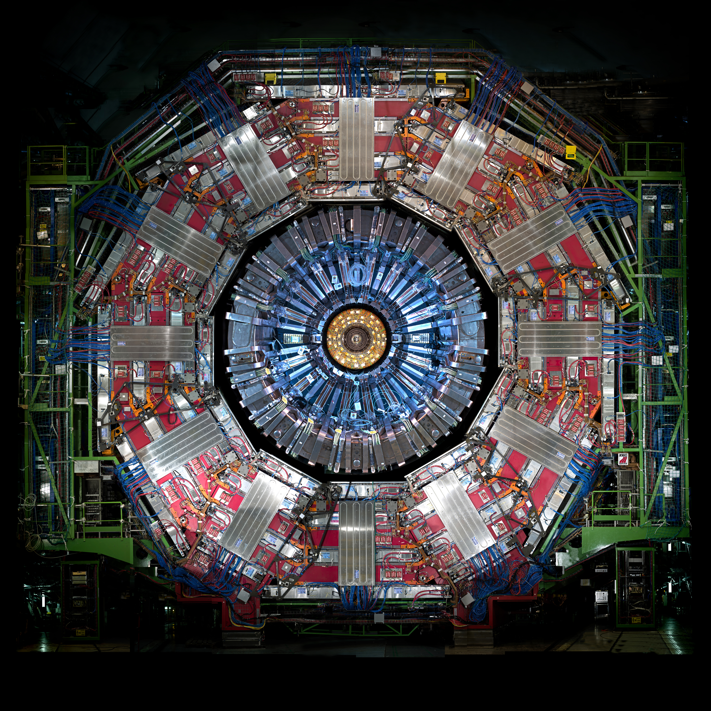
Compact Muon Solenoid (CMS)
Silicon tracker
Solid-state pixel and strip detectors
Detects charged particle tracks
Electromagnetic calorimeter (ECAL)
Homogenous detector
Consists of 75,000 PbWO₄ crystals
Detects electromagnetically interacting particle showers
Hadronic calorimeter (HCAL)
Sampling calorimeter
Layers of plastic scintillator and brass absorbers
Detects neutral and charged hadrons
Solenoid Magnet
Bends charged particles to measure momentum
Muon chambers
Detects muons
Notes:
Sampling vs Homogenous are two the different types of calorimeters. Sampling is like the HCAL where two materials alternate to cause showers and measure the decays. Homogeneous calorimeters are made of one material that both causes and measures the particle shower (e.g. ECAL).

Slide 7
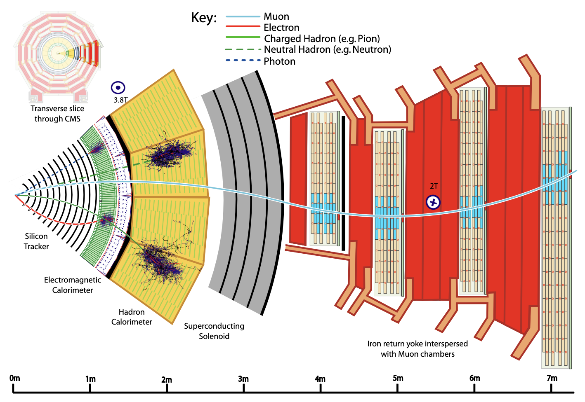
Object Reconstruction
Particle Flow (PF) Algorithm
Takes raw hits in the detector and creates PF elements
Links PF elements between sub-detectors to create particle candidates
Reconstruct muons
Electrons and isolated photons
Charged/neutral hadrons and non-isolated photons
Combines particle candidates to build a picture of a collision event

Slide 8
Technical Work

Slide 9
The Standard Model and Beyond
LHC and CMS
Introduction to Analysis
Sample Generation
Event Selection
Signal Modelling
Advancements on Previous Studies
Summary
Notes:
Introduction – what am I doing? Basic why is it interesting?
The Standard Model and Beyond – theory stuff
LHC and CMS – also mention service work here briefly
Sample Generation – signal MC and event mixing part
Event Selection – cuts, BDT, categorization
Signal Modelling – signal modelling + note on background fits
Advancements on Previous Studies – exactly what it sounds like
Summary – put everything together for questions
REMEMBER TO INCLUDE PLOTS!!!!!!!

Slide 10
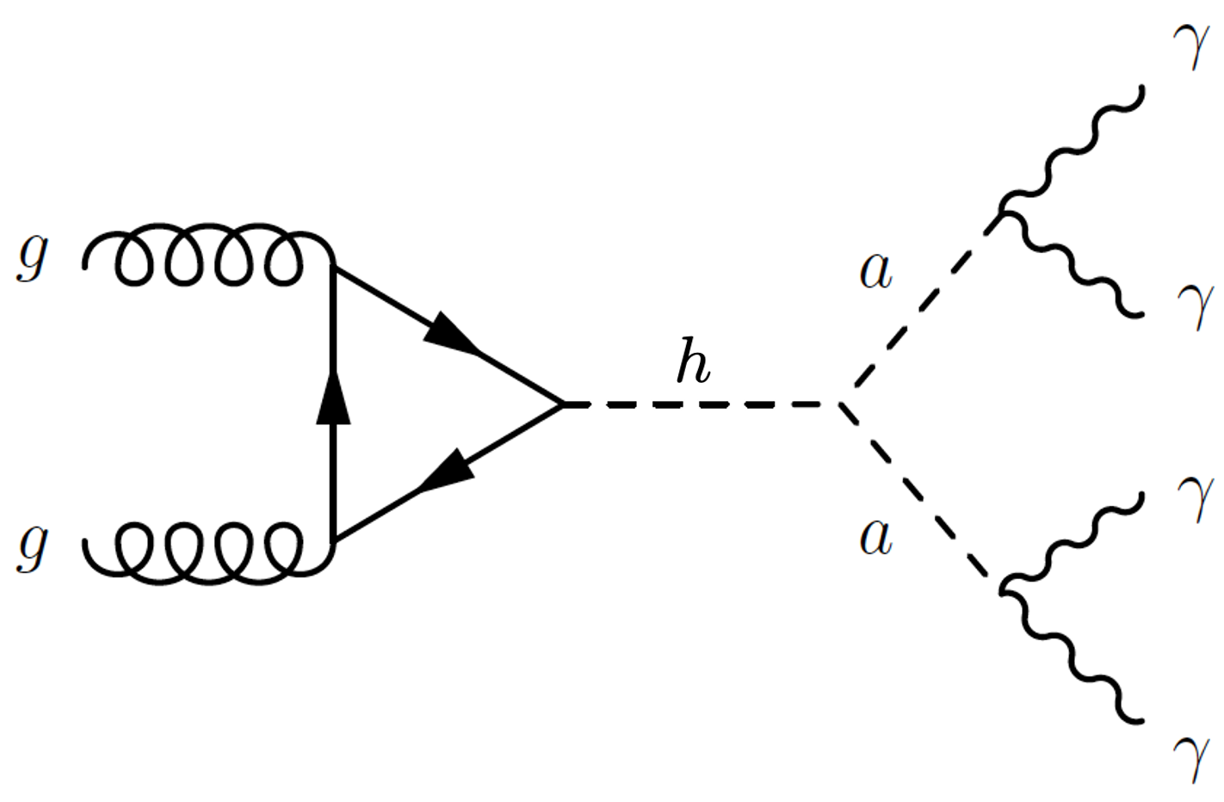
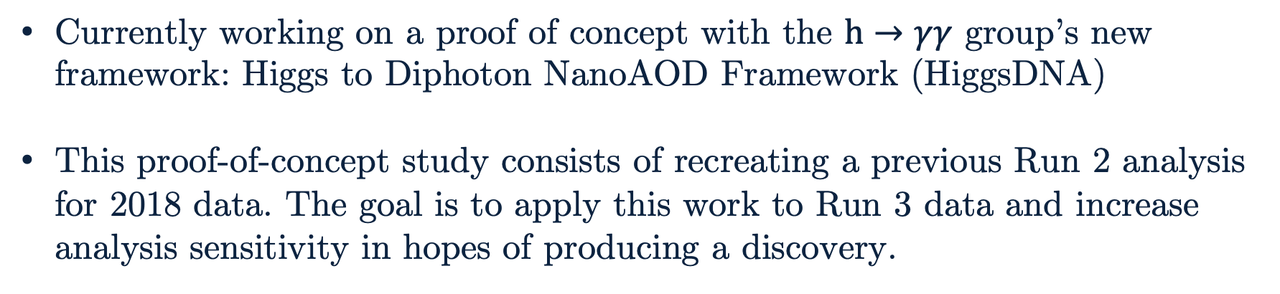
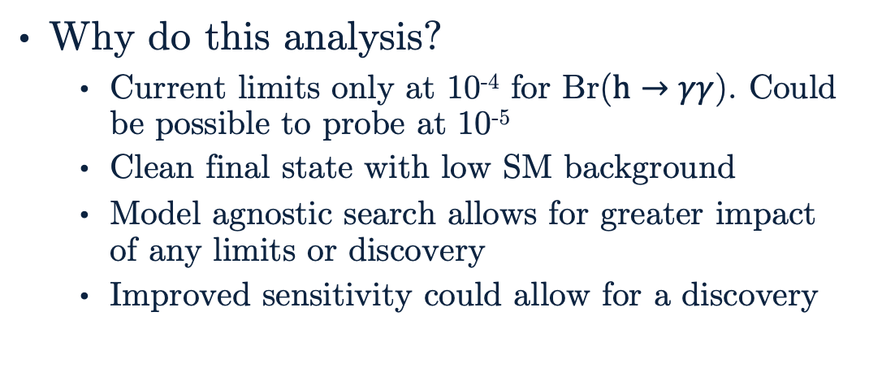
Introduction to Analysis
Why do this analysis?
Current limits only at 10⁻⁴ for Br($h→γγ$). Could be possible to probe at 10⁻⁵
Clean final state with low SM background
Model agnostic search allows for greater impact of any limits or discovery
Improved sensitivity could allow for a discovery
Currently working on a proof of concept with the $h→γγ$ group’s new framework: Higgs to Diphoton NanoAOD Framework (HiggsDNA)
This proof-of-concept study consists of recreating a previous Run 2 analysis for 2018 data. The goal is to apply this work to Run 3 data and increase analysis sensitivity in hopes of producing a discovery.

Slide 11
Analysis Overview
nanoAOD Samples
Apply Selections with HiggsDNA
BDT Training
BDT Score Categories
Signal MC
Event Mixed
Background
Data
Low mass diphoton selections
N-dim reweighting of samples for BDT training
Process samples with BDT model
1-dim reweighting of BDT scores
Photon selections
Training event selection BDT
Optimize and cut on categories
x
Background Modelling
Signal Modelling
Next Steps…
Limit Setting
Discovery?
Generate nominal mass point models
Generate models for all mass points
Generate intermediate mass point models

Slide 12
The Standard Model and Beyond
LHC and CMS
Introduction to Analysis
Sample Generation
Event Selection
Signal Modelling
Advancements on Previous Studies
Summary
Notes:
Introduction – what am I doing? Basic why is it interesting?
The Standard Model and Beyond – theory stuff
LHC and CMS – also mention service work here briefly
Sample Generation – signal MC and event mixing part
Event Selection – cuts, BDT, categorization
Signal Modelling – signal modelling + note on background fits
Advancements on Previous Studies – exactly what it sounds like
Summary – put everything together for questions
REMEMBER TO INCLUDE PLOTS!!!!!!!

Slide 13
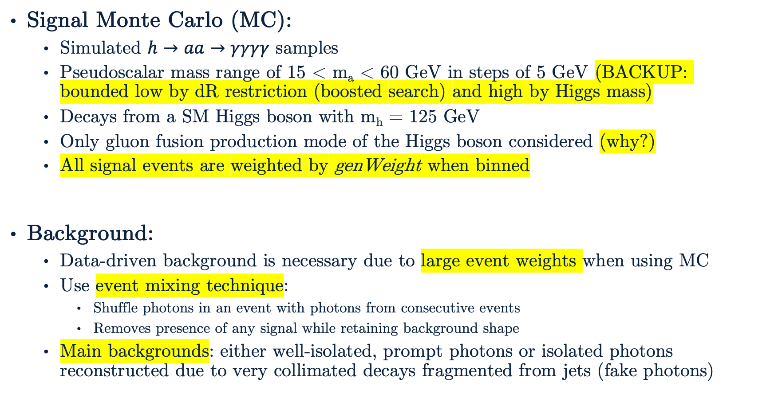
Sample Generation
Signal Monte Carlo (MC):
Simulated $h→aa→γγγγ$ samples
Pseudoscalar mass range of 15 < m_{a} < 60 GeV in steps of 5 GeV (BACKUP: bounded low by dR restriction (boosted search) and high by Higgs mass)
Decays from a SM Higgs boson with m_{h} = 125 GeV
Only gluon fusion production mode of the Higgs boson considered (why?)
All signal events are weighted by genWeight when binned
Background:
Data-driven background is necessary due to large event weights when using MC
Use event mixing technique:
Shuffle photons in an event with photons from consecutive events
Removes presence of any signal while retaining background shape
Main backgrounds: either well-isolated, prompt photons or isolated photons reconstructed due to very collimated decays fragmented from jets (fake photons)

Slide 14
The Standard Model and Beyond
LHC and CMS
Introduction to Analysis
Sample Generation
Event Selection
Signal Modelling
Advancements on Previous Studies
Summary
Notes:
Introduction – what am I doing? Basic why is it interesting?
The Standard Model and Beyond – theory stuff
LHC and CMS – also mention service work here briefly
Sample Generation – signal MC and event mixing part
Event Selection – cuts, BDT, categorization
Signal Modelling – signal modelling + note on background fits
Advancements on Previous Studies – exactly what it sounds like
Summary – put everything together for questions
REMEMBER TO INCLUDE PLOTS!!!!!!!

Slide 15
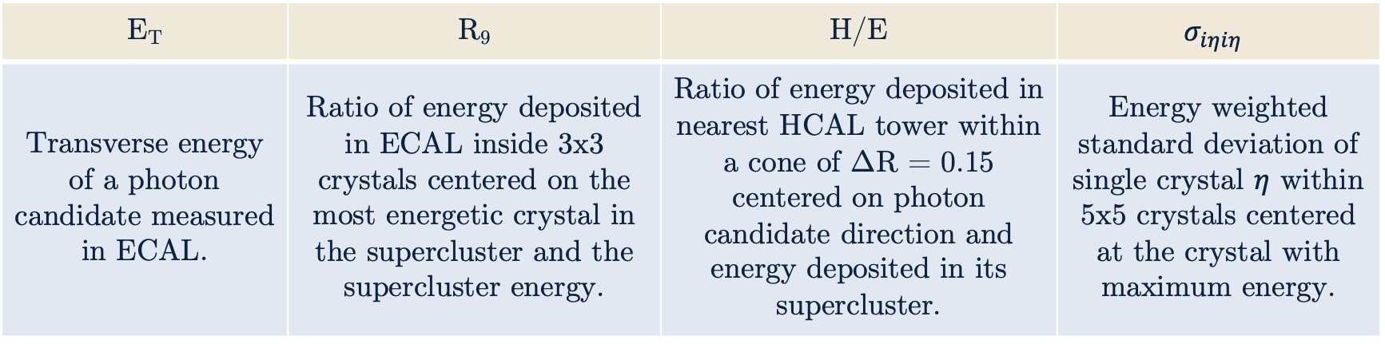
Choosing Candidate Photons
Energy deposition and shape of photon candidates:
E_{T} | R₉ | H/E | $$σ_{iηiη}$$
Transverse energy of a photon candidate measured in ECAL. | Ratio of energy deposited in ECAL inside 3x3 crystals centered on the most energetic crystal in the supercluster and the supercluster energy. | Ratio of energy deposited in nearest HCAL tower within a cone of ΔR = 0.15 centered on photon candidate direction and energy deposited in its supercluster. | Energy weighted standard deviation of single crystal $η$ within 5x5 crystals centered at the crystal with maximum energy.
Isolation of photon candidates:
Particle Flow Photon Isolation | Tracker Isolation | Charged Hadron Isolation | Electron Veto
Sum of E_{T} of all Particle Flow photon candidates within a cone of ΔR = 0.3 excluding candidate photon. | Sum of track p_{T} within a cone of ΔR = 0.3. | Sum of p_{T} of all Particle Flow charged hadron candidates within a cone of ΔR = 0.3. | Checks that no matching electron candidate track matches photon candidate supercluster.
Notes:
Important to note why each variable is used as a cut. Not important to mention the values beyond resolution(?) of photons below 15 GeV
TALK ABOUT WHAT EVERY VARIABLE MEANS!!!

Slide 16
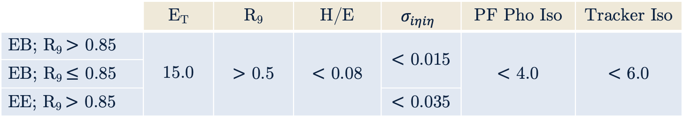
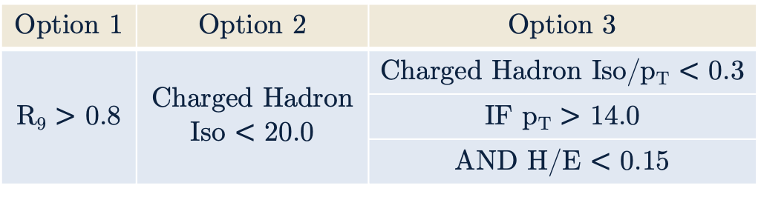
Pre-selections
 | E_{T} | R₉ | H/E | $$σ_{iηiη}$$ | PF Pho Iso | Tracker Iso
EB; R₉ $>$ 0.85 | 15.0 | $>$ 0.5 | $<$ 0.08 | $<$ 0.015 | $<$ 4.0 | $<$ 6.0
EB; R₉ $≤$ 0.85
EE; R₉ $>$ 0.85 |  |  |  | $<$ 0.035
Selections slightly more strict than High Level Trigger (HLT) are applied
Events must pass at least one of Option 1-3 (motivated by miniAOD cuts)
Photons must also pass an electron veto
Events must have at least two photon candidates
Diphoton candidates require p_{T} > 30 GeV and p_{T} > 18 GeV for leading and subleading daughter photons
Option 1 | Option 2 | Option 3
R₉ $>$ 0.8 | Charged Hadron Iso $<$ 20.0 | Charged Hadron Iso/p_{T} $<$ 0.3
 |  | IF p_{T} $>$ 14.0
 |  | AND H/E $<$ 0.15
Notes:
Important to note why each variable is used as a cut. Not important to mention the values beyond resolution(?) of photons below 15 GeV
TALK ABOUT WHAT EVERY VARIABLE MEANS!!!

Slide 17
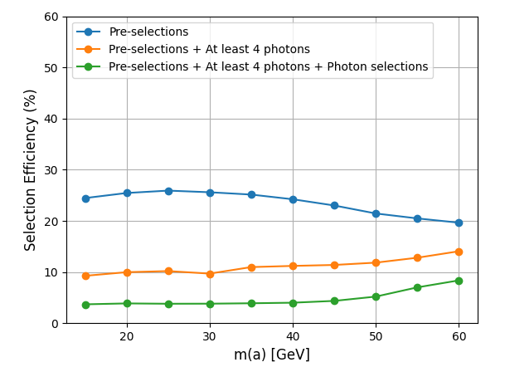
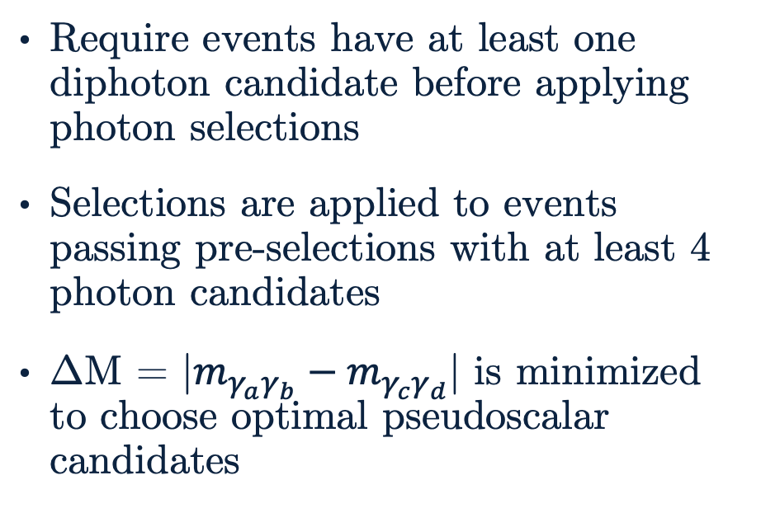
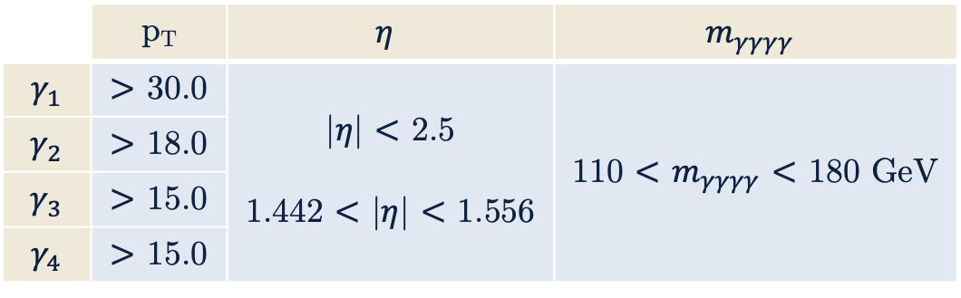
Photon Selections
Require events have at least one diphoton candidate before applying photon selections
Selections are applied to events passing pre-selections with at least 4 photon candidates
ΔM = |$m_{γ_{a}γ_{b}}−m_{γ_{c}γ_{d}}$| is minimized to choose optimal pseudoscalar candidates
 | p_{T} | $$η$$ | $$m_{γγγγ}$$
$$γ_{1}$$ | $>$ 30.0 | |$η$| $<$ 2.5 1.442 $<$ |$η$| $<$ 1.556 | 110 $<$ $m_{γγγγ}$ $<$ 180 GeV
$$γ_{2}$$ | $>$ 18.0
$$γ_{3}$$ | $>$ 15.0
$$γ_{4}$$ | $>$ 15.0
Above: Efficiencies of selections at various stages of selections for all nominal pseudoscalar mass points. This should improve at higher mass points.
Left: Additional selections applied to photons passing pre-selections.
Notes:
TALK ABOUT WHAT EVERY VARIABLE MEANS!!!

Slide 18
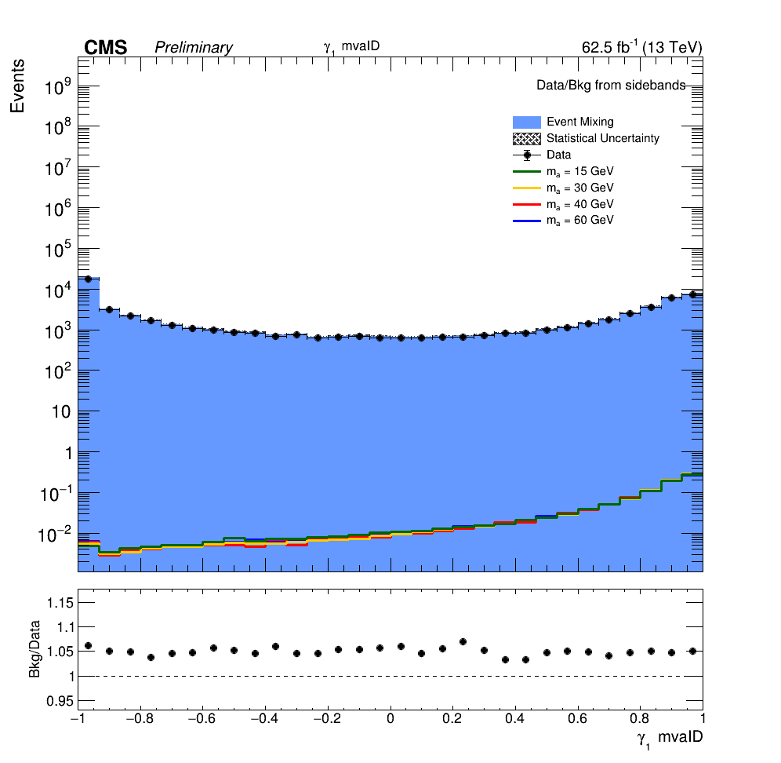
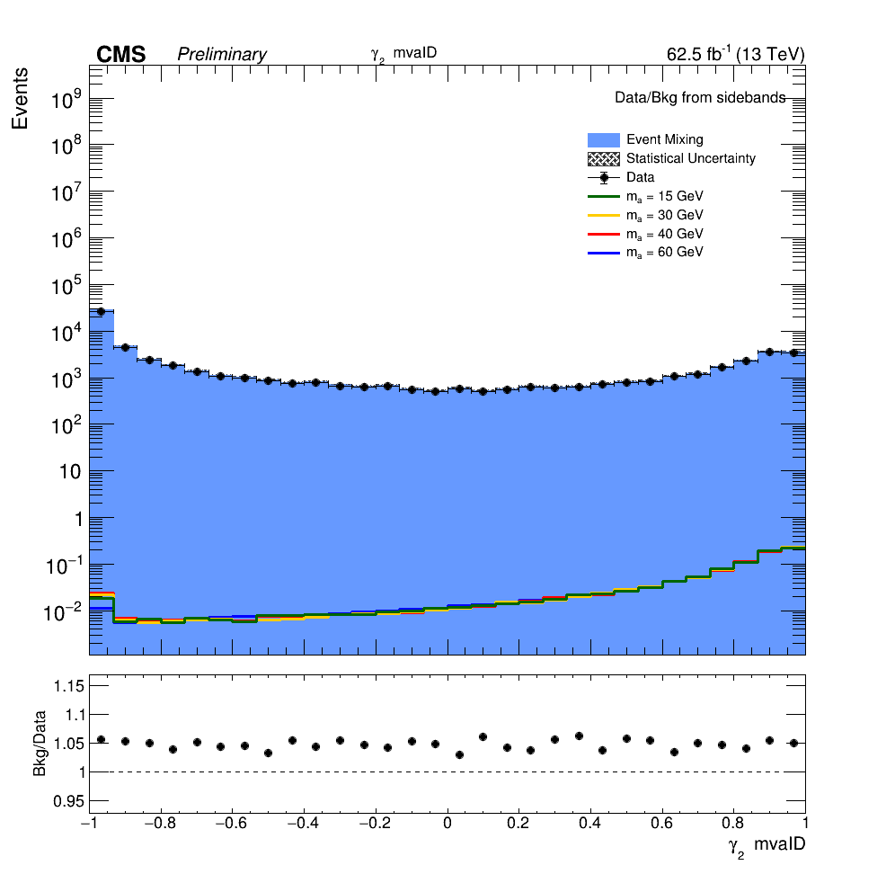
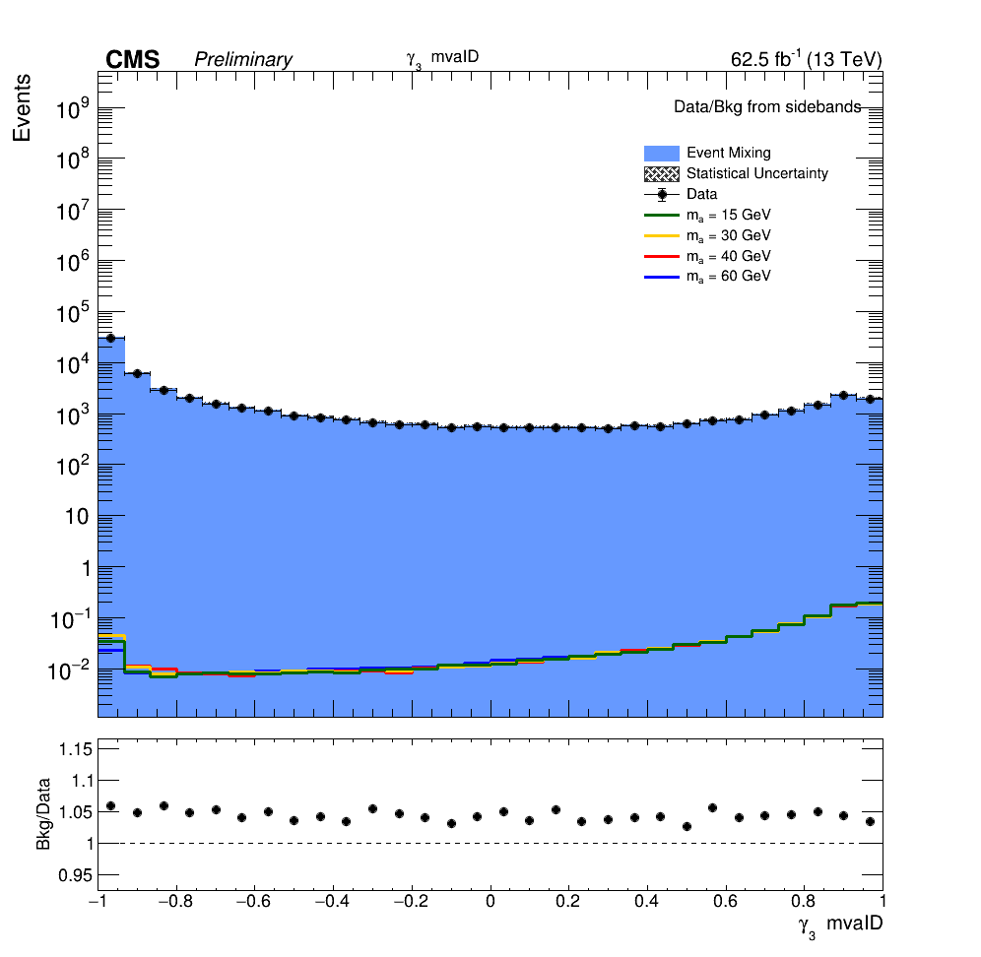
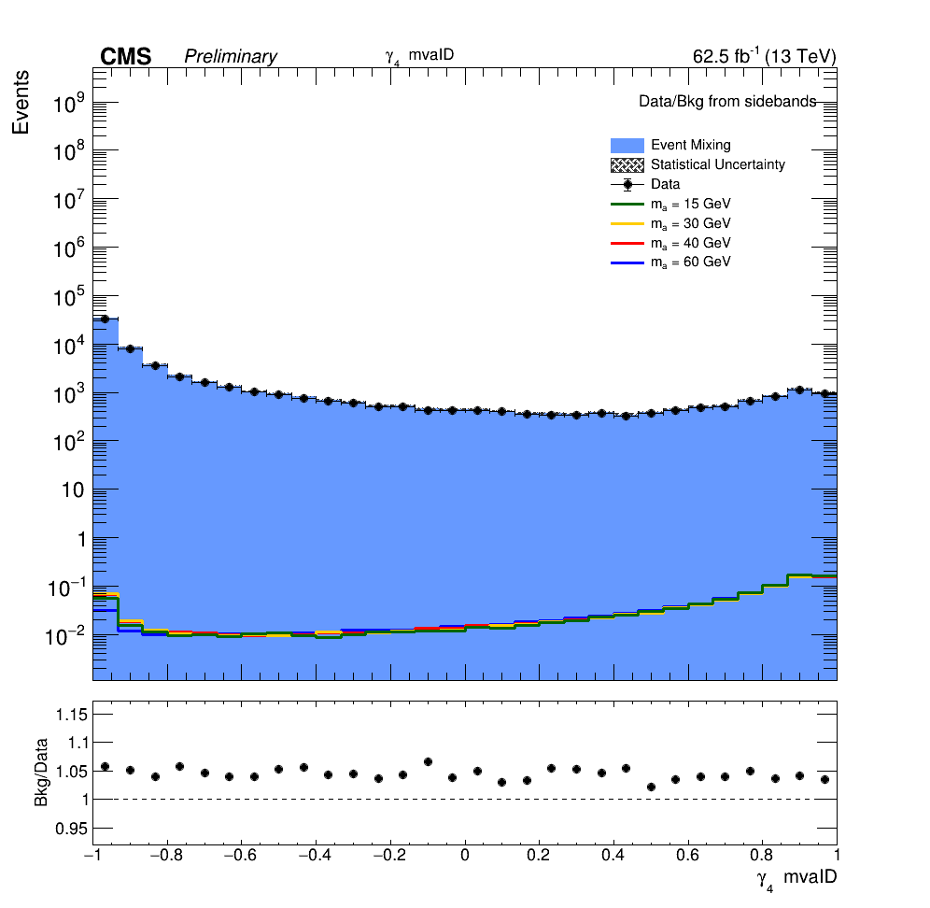
Results of Selections
Photon MVA ID

Slide 19
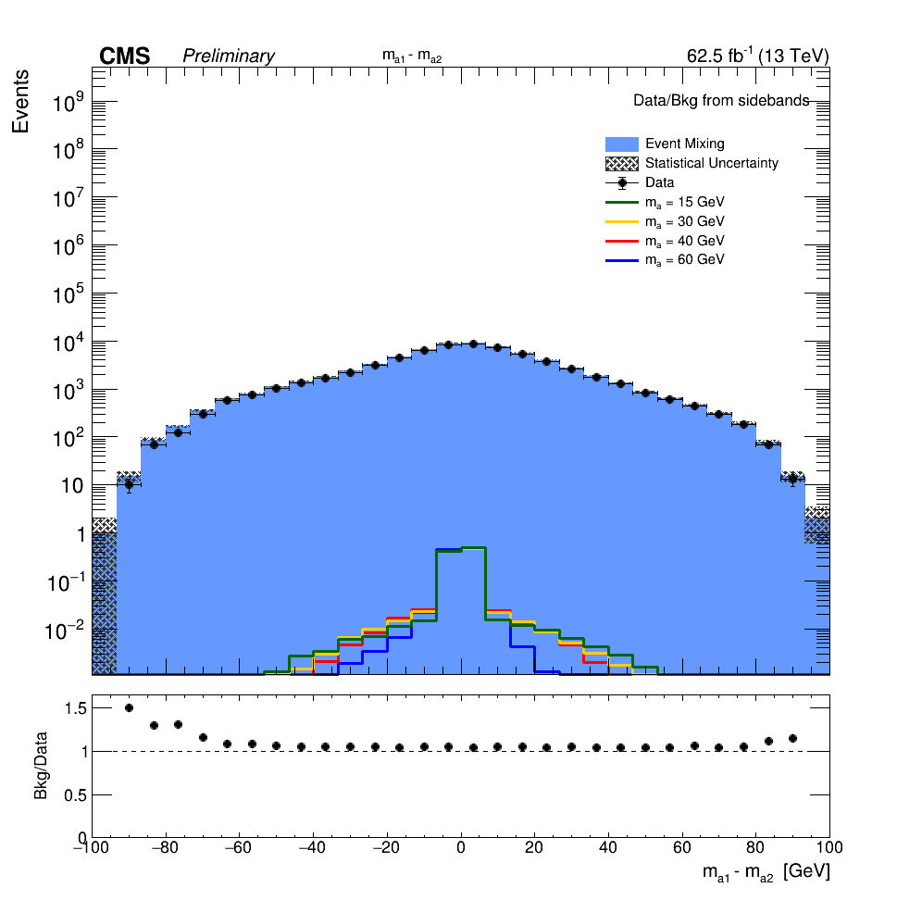
Results of Selections (cont.)
Pseudoscalar Mass Difference

Slide 20
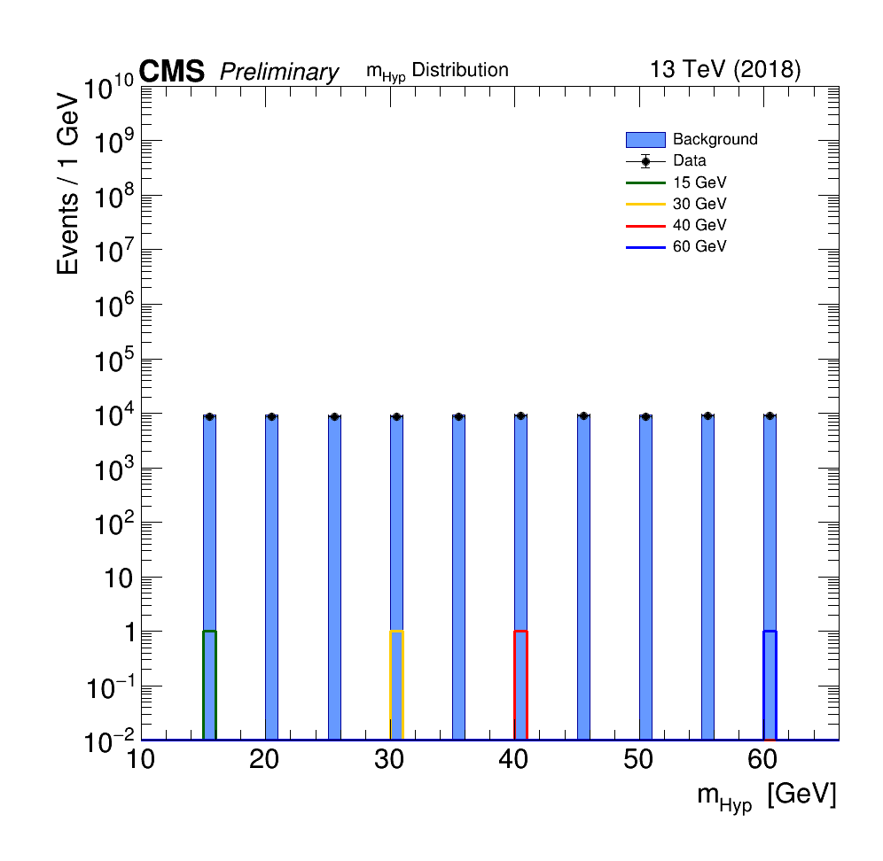
Event Selection BDT
What is a BDT?
Boosted Decision Tree
Combination of many weak learners (trees) into a strong classifier
Need a BDT to better distinguish signal-like events from background-like events
A BDT can significantly improve analysis sensitivity compared to a purely cut-based analysis.
One event selection BDT model is produced for all mass points, made possible by using a constructed variable: hypothesis mass or m_{Hyp}
Right: Distribution of m_{Hyp} for signal MC of several nominal mass points, event mixed background, and data. m_{Hyp} has the associated value for a given pseudoscalar mass point for signal MC but a flat distribution for event mixed background and data, by construction.

Slide 21
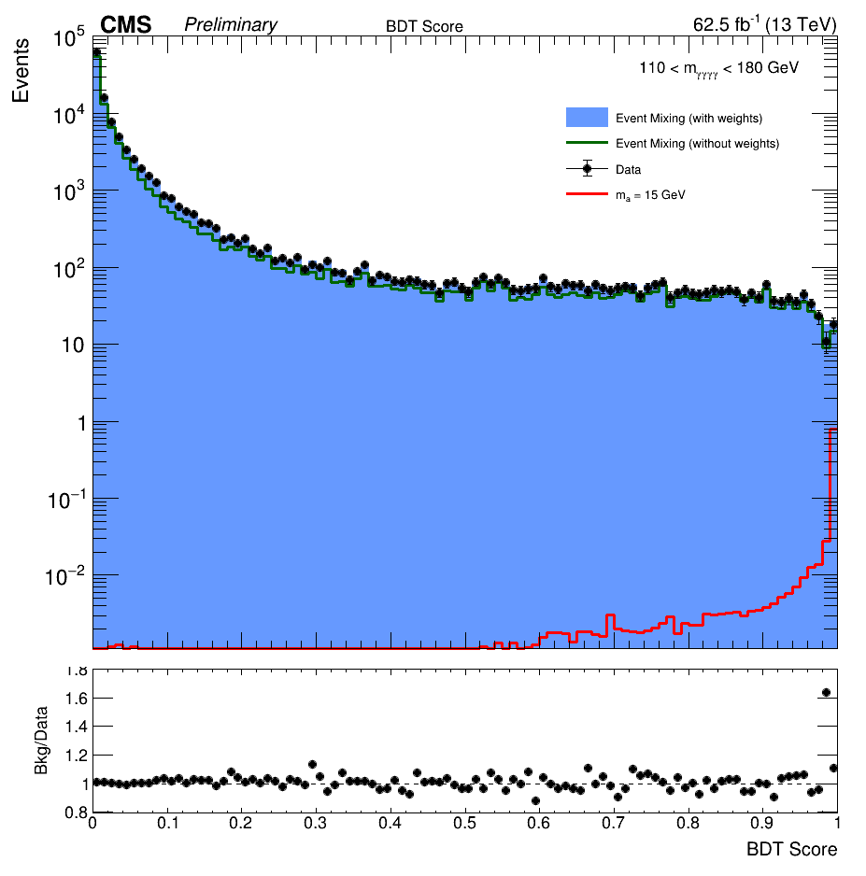
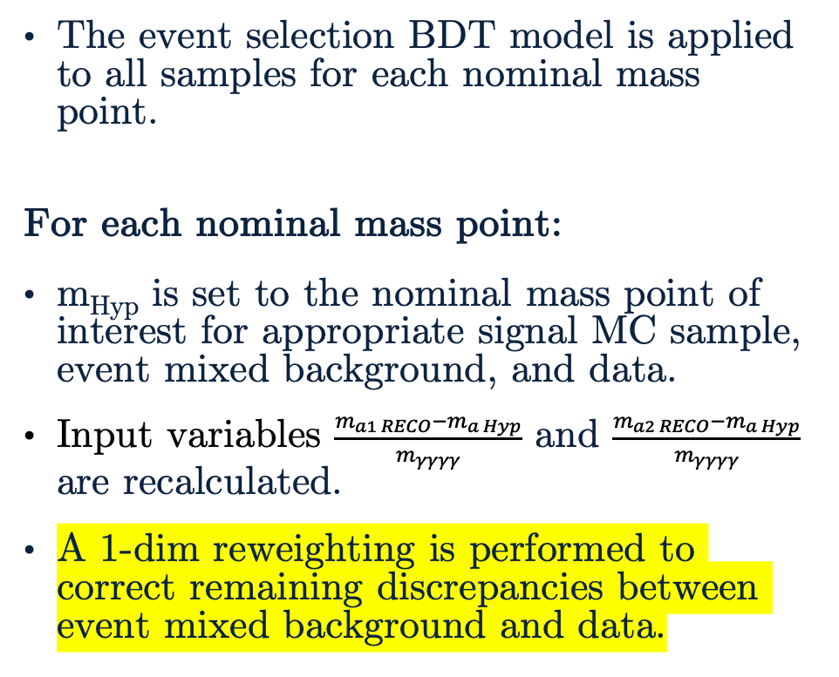
Applying the Event Selection BDT
The event selection BDT model is applied to all samples for each nominal mass point.
For each nominal mass point:
m_{Hyp} is set to the nominal mass point of interest for appropriate signal MC sample, event mixed background, and data.
Input variables $\frac{m_{a1 RECO}−m_{a Hyp}}{m_{γγγγ}}$ and $\frac{m_{a2 RECO}−m_{a Hyp}}{m_{γγγγ}}$ are recalculated.
A 1-dim reweighting is performed to correct remaining discrepancies between event mixed background and data.
Right: Distribution of event selection BDT score for signal MC, event mixed background, data for m_{a} = 15 GeV. The pre-reweighting event mixed background distribution is shown.

Slide 22
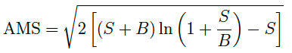
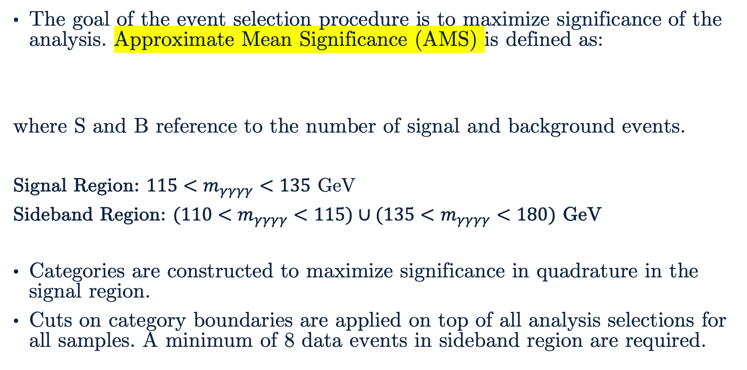
BDT Score Categorization
The goal of the event selection procedure is to maximize significance of the analysis. Approximate Mean Significance (AMS) is defined as:
where S and B reference to the number of signal and background events.
Signal Region: $115<m_{γγγγ}<135$ GeV
Sideband Region: $(110<m_{γγγγ}<115)∪(135<m_{γγγγ}<180)$ GeV
Categories are constructed to maximize significance in quadrature in the signal region.
Cuts on category boundaries are applied on top of all analysis selections for all samples. A minimum of 8 data events in sideband region are required.

Slide 23
The Standard Model and Beyond
LHC and CMS
Introduction to Analysis
Sample Generation
Event Selection
Signal Modelling
Advancements on Previous Studies
Summary
Notes:
Introduction – what am I doing? Basic why is it interesting?
The Standard Model and Beyond – theory stuff
LHC and CMS – also mention service work here briefly
Sample Generation – signal MC and event mixing part
Event Selection – cuts, BDT, categorization
Signal Modelling – signal modelling + note on background fits
Advancements on Previous Studies – exactly what it sounds like
Summary – put everything together for questions
REMEMBER TO INCLUDE PLOTS!!!!!!!

Slide 24
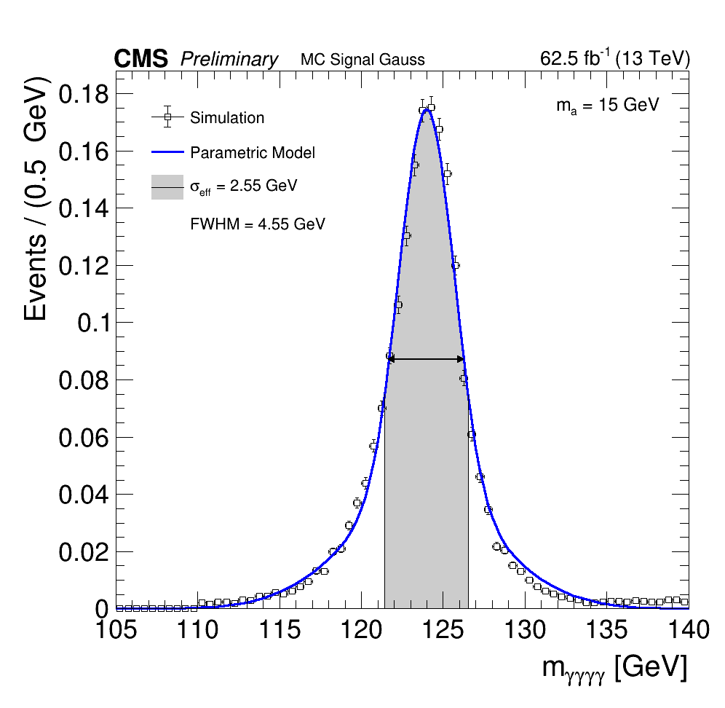
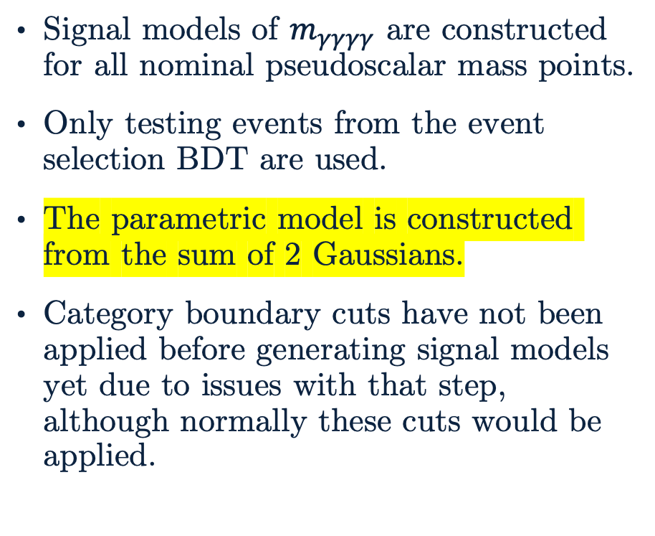
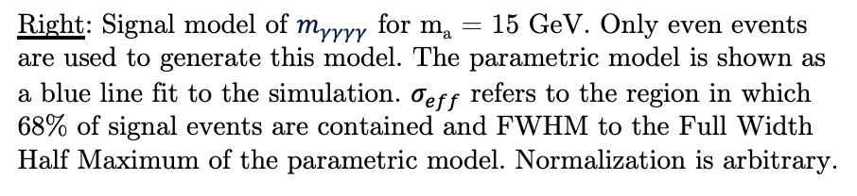
Signal Modelling
Signal models of $m_{γγγγ}$ are constructed for all nominal pseudoscalar mass points.
Only testing events from the event selection BDT are used.
The parametric model is constructed from the sum of 2 Gaussians.
Category boundary cuts have not been applied before generating signal models yet due to issues with that step, although normally these cuts would be applied.
Right: Signal model of $m_{γγγγ}$ for m_{a} = 15 GeV. Only even events are used to generate this model. The parametric model is shown as a blue line fit to the simulation. $σ_{eff}$ refers to the region in which 68% of signal events are contained and FWHM to the Full Width Half Maximum of the parametric model. Normalization is arbitrary.

Slide 25
The Standard Model and Beyond
LHC and CMS
Introduction to Analysis
Sample Generation
Event Selection
Signal Modelling
Advancements on Previous Studies
Summary
Notes:
Introduction – what am I doing? Basic why is it interesting?
The Standard Model and Beyond – theory stuff
LHC and CMS – also mention service work here briefly
Sample Generation – signal MC and event mixing part
Event Selection – cuts, BDT, categorization
Signal Modelling – signal modelling + note on background fits
Advancements on Previous Studies – exactly what it sounds like
Summary – put everything together for questions
REMEMBER TO INCLUDE PLOTS!!!!!!!

Slide 26
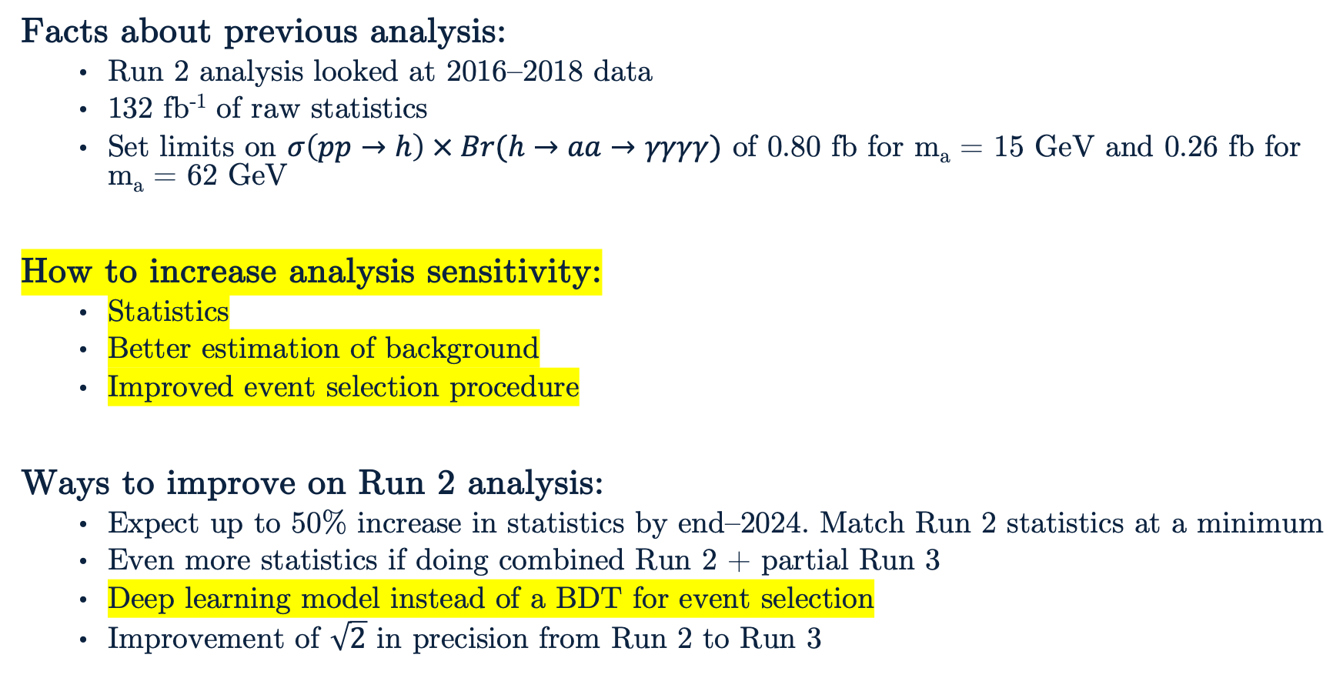
Advancements on Previous Studies
Facts about previous analysis:
Run 2 analysis looked at 2016–2018 data
132 fb⁻¹ of raw statistics
Set limits on $σ\left(pp→h\right) × Br(h→aa→γγγγ)$ of 0.80 fb for m_{a} = 15 GeV and 0.26 fb for m_{a} = 62 GeV
How to increase analysis sensitivity:
Statistics
Better estimation of background
Improved event selection procedure
Ways to improve on Run 2 analysis:
Expect up to 50% increase in statistics by end–2024. Match Run 2 statistics at a minimum
Even more statistics if doing combined Run 2 + partial Run 3
Deep learning model instead of a BDT for event selection
Improvement of $\sqrt{2}$ in precision from Run 2 to Run 3

Slide 27
The Standard Model and Beyond
LHC and CMS
Introduction to Analysis
Sample Generation
Event Selection
Signal Modelling
Advancements on Previous Studies
Summary
Notes:
Introduction – what am I doing? Basic why is it interesting?
The Standard Model and Beyond – theory stuff
LHC and CMS – also mention service work here briefly
Sample Generation – signal MC and event mixing part
Event Selection – cuts, BDT, categorization
Signal Modelling – signal modelling + note on background fits
Advancements on Previous Studies – exactly what it sounds like
Summary – put everything together for questions
REMEMBER TO INCLUDE PLOTS!!!!!!!

Slide 28
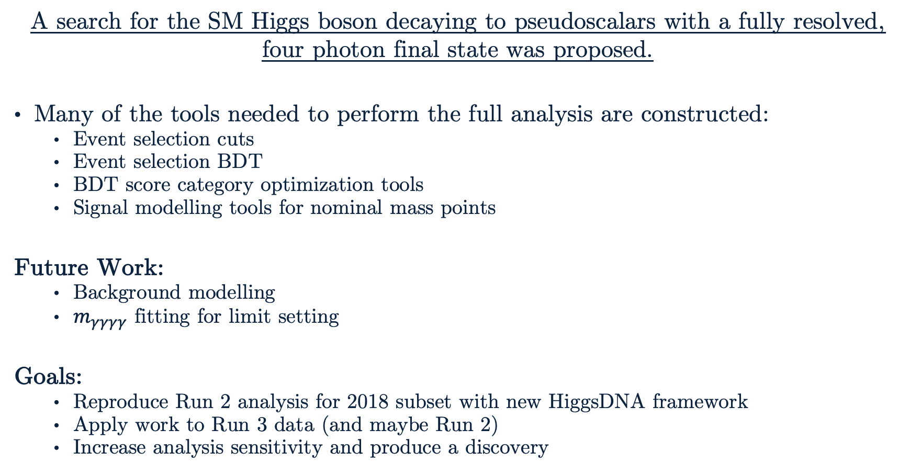
Summary
A search for the SM Higgs boson decaying to pseudoscalars with a fully resolved, four photon final state was proposed.
Many of the tools needed to perform the full analysis are constructed:
Event selection cuts
Event selection BDT
BDT score category optimization tools
Signal modelling tools for nominal mass points
Future Work:
Background modelling
$m_{γγγγ}$ fitting for limit setting
Goals:
Reproduce Run 2 analysis for 2018 subset with new HiggsDNA framework
Apply work to Run 3 data (and maybe Run 2)
Increase analysis sensitivity and produce a discovery

Slide 29
Thank You!

Slide 30
Backup

Slide 31
Backup Slide #1
See yellow highlights for more backup slides!
Higgs mechanism and EWSB
Internal local symmetries of SM (alpha(point) varies. Not same for all space – that’s global symmetry)
Conversion of samples from miniAOD to nanoAOD
More BDT explanation: https://indico.fnal.gov/event/15356/contributions/31377/attachments/19671/24560/DecisionTrees.pdf
Higgs production cross section for all channels combined is 52 pb (https://arxiv.org/abs/1610.07922)
Vacuum of LHCNotes on photon variables: https://twiki.cern.ch/twiki/bin/viewauth/CMS/SWGuideCMSDataAnalysisSchoolLPC2018egamma
Repeats of plots already included but for a different mass points (15, 30, 40, 60 GeV?)

Slide 32
Backup Slide #2
Possibly the only decay (a->gg) of pseudoscalars depending on model (BACKUP?)
Note about background modelling as nuisance parameter when extracting limits?
To do stuff: limit extraction, background modelling, signal modelling for intermediate mass points, applying corrections (smearing and shower shape for photons), applying systematic error/variation
Deep learning model (Keras network vs tree)
Better with lower-level variables. Still might be possible given the work done to add extra branches to the samples anyway

Slide 33
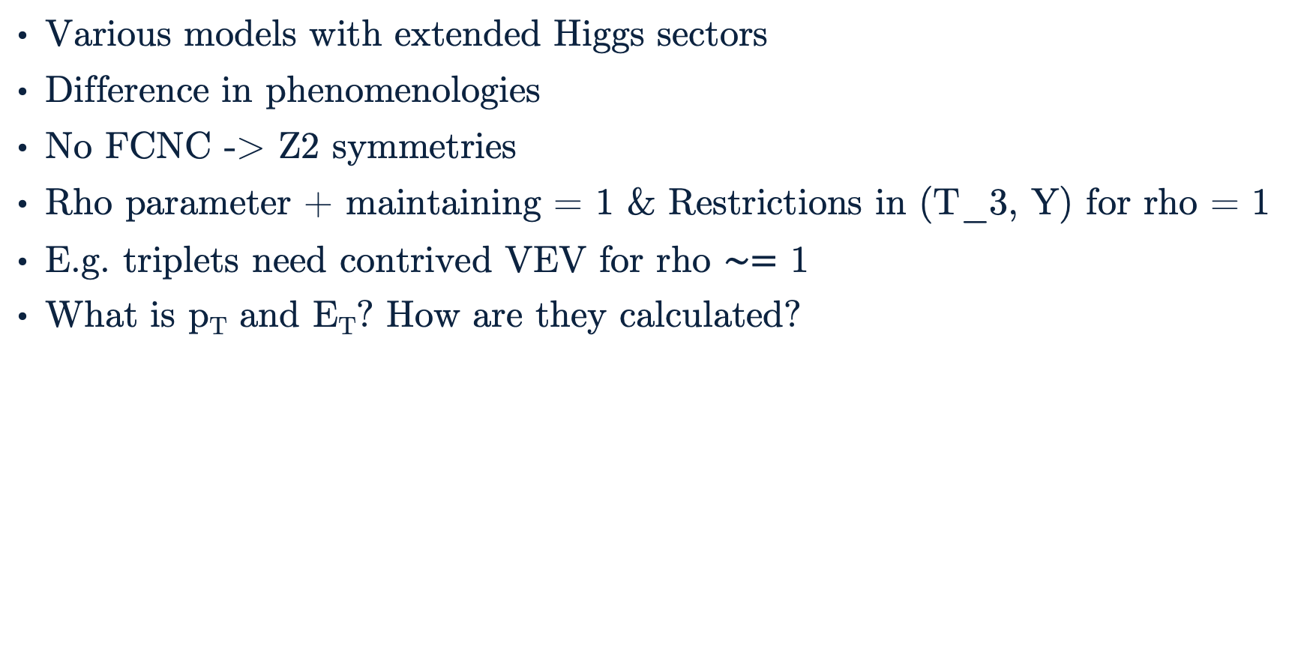
Extended Higgs Sectors
Various models with extended Higgs sectors
Difference in phenomenologies
No FCNC -> Z2 symmetries
Rho parameter + maintaining = 1 & Restrictions in (T_3, Y) for rho = 1
E.g. triplets need contrived VEV for rho $∼=$ 1
What is p_{T} and E_{T}? How are they calculated?

Slide 34
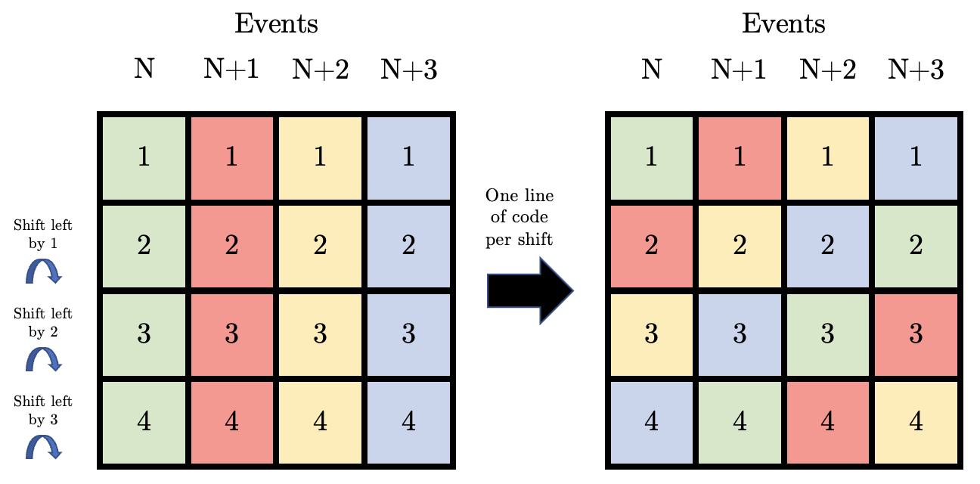
Event Mixing
Expected shuffling:
Events are color coded and then shuffled.
How to read: Event N has photon N → event N, photon 2 → event N+1, etc.
Observed shuffling:
Photon 1 (Evt 1) → Photon 1 (Evt 1)
Photon 2 (Evt 1) → Photon 2 (Evt 2)
Photon 3 (Evt 1) → Photon 3 (Evt 3)
Photon 4 (Evt 1) → Photon 4 (Evt 4)
And so on for the other events…

Slide 35
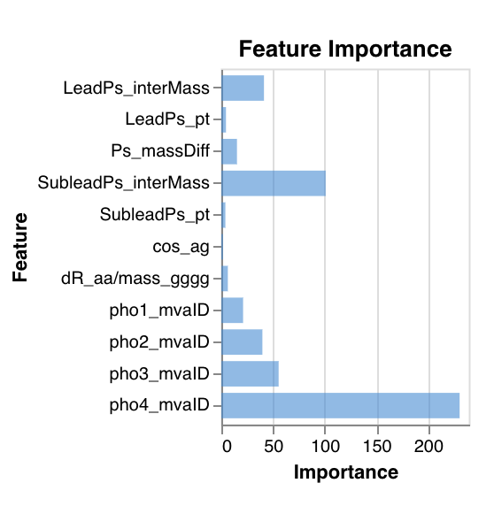
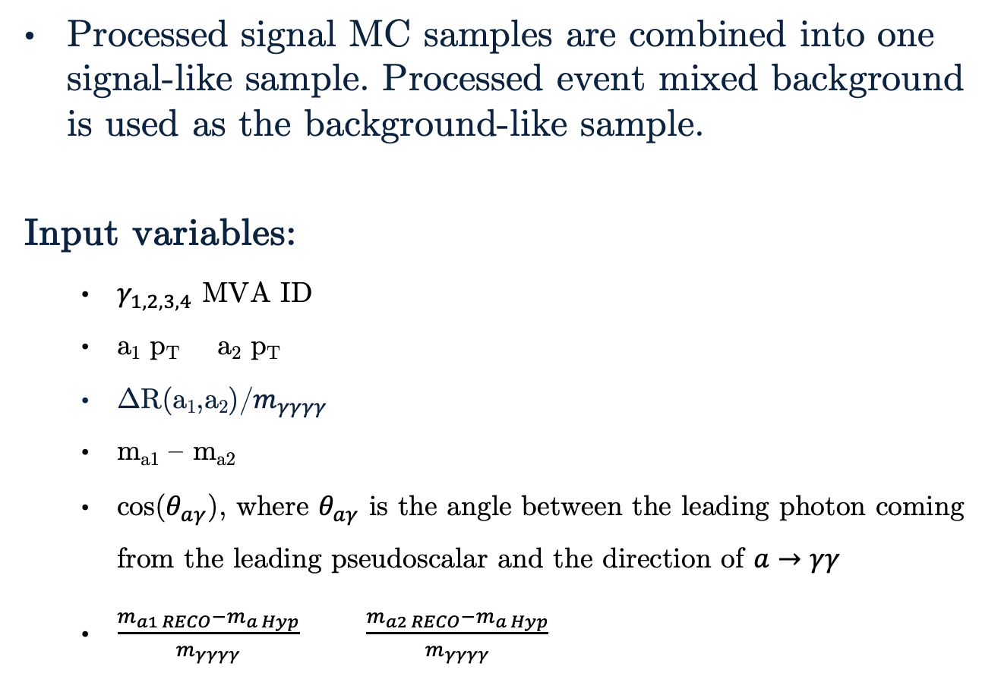
Event Selection BDT Inputs
Processed signal MC samples are combined into one signal-like sample. Processed event mixed background is used as the background-like sample.
Input variables:
$γ_{1,2,3,4}$ MVA ID
a₁ p_{T} a₂ p_{T}
ΔR(a₁,a₂)/$m_{γγγγ}$
m_{a1} – m_{a2}
cos($θ_{aγ}$), where $θ_{aγ}$ is the angle between the leading photon coming from the leading pseudoscalar and the direction of $a→γγ$
$\frac{m_{a1 RECO}−m_{a Hyp}}{m_{γγγγ}}$ $\frac{m_{a2 RECO}−m_{a Hyp}}{m_{γγγγ}}$
Above: Chart of feature importance for the event selection BDT input variables from one of the best performing models.

Slide 36
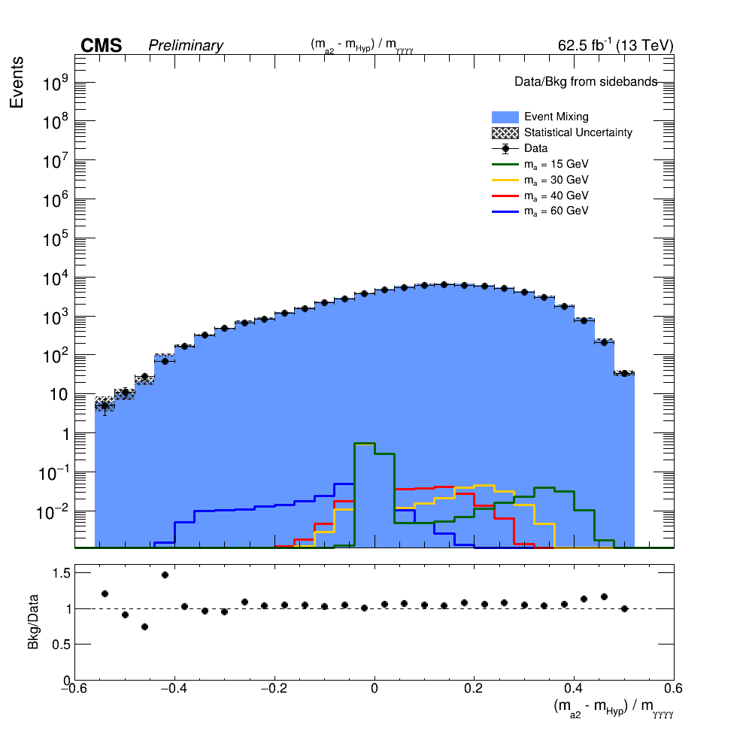
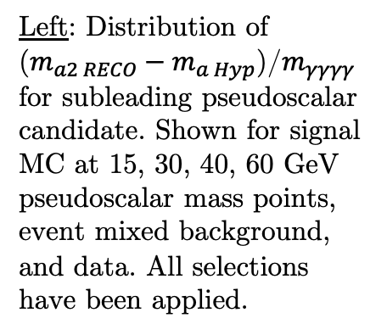
Important BDT Input Variables
Left: Distribution of ($m_{a2 RECO}−m_{a Hyp}$)/$m_{γγγγ}$ for subleading pseudoscalar candidate. Shown for signal MC at 15, 30, 40, 60 GeV pseudoscalar mass points, event mixed background, and data. All selections have been applied.
Above: Chart of feature importance for the event selection BDT input variables from one of the best performing models.

Slide 37
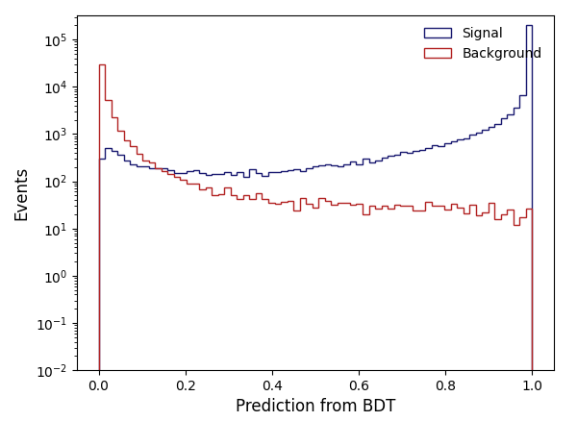
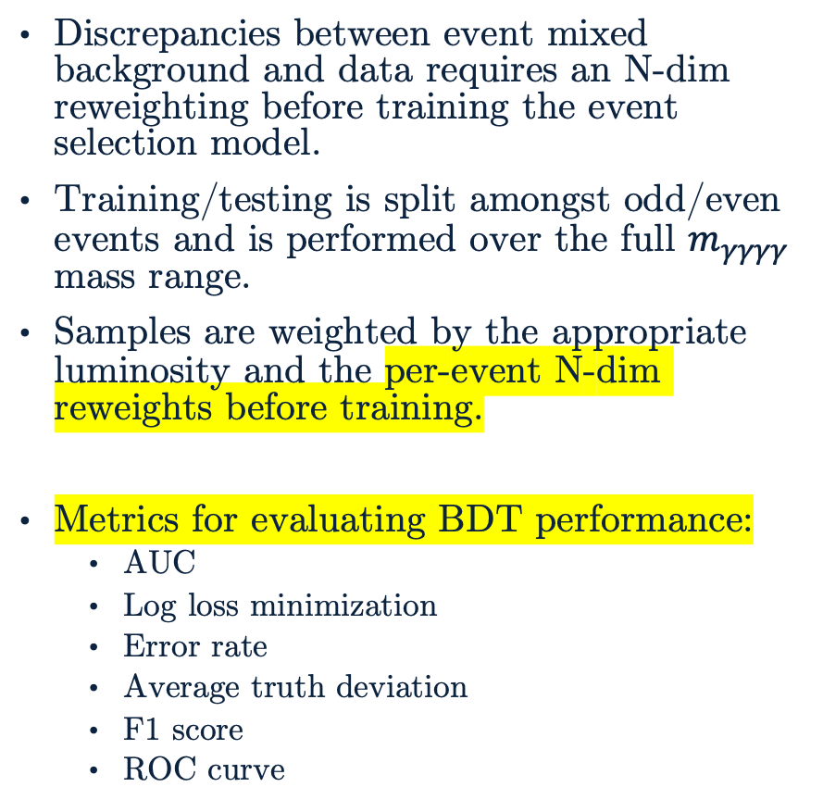
Training the Event Selection BDT
Discrepancies between event mixed background and data requires an N-dim reweighting before training the event selection model.
Training/testing is split amongst odd/even events and is performed over the full $m_{γγγγ}$ mass range.
Samples are weighted by the appropriate luminosity and the per-event N-dim reweights before training.
Metrics for evaluating BDT performance:
AUC
Log loss minimization
Error rate
Average truth deviation
F1 score
ROC curve
Above: Event selection BDT predictions for training set using processed signal MC and event mixed background.

Slide 38
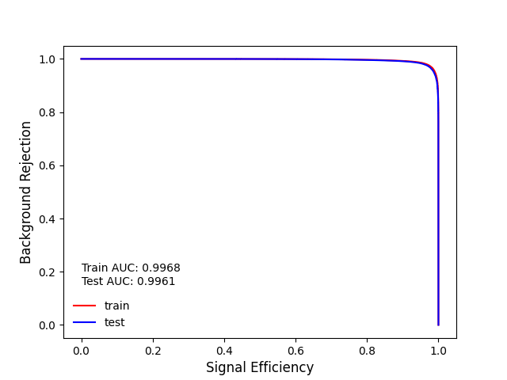
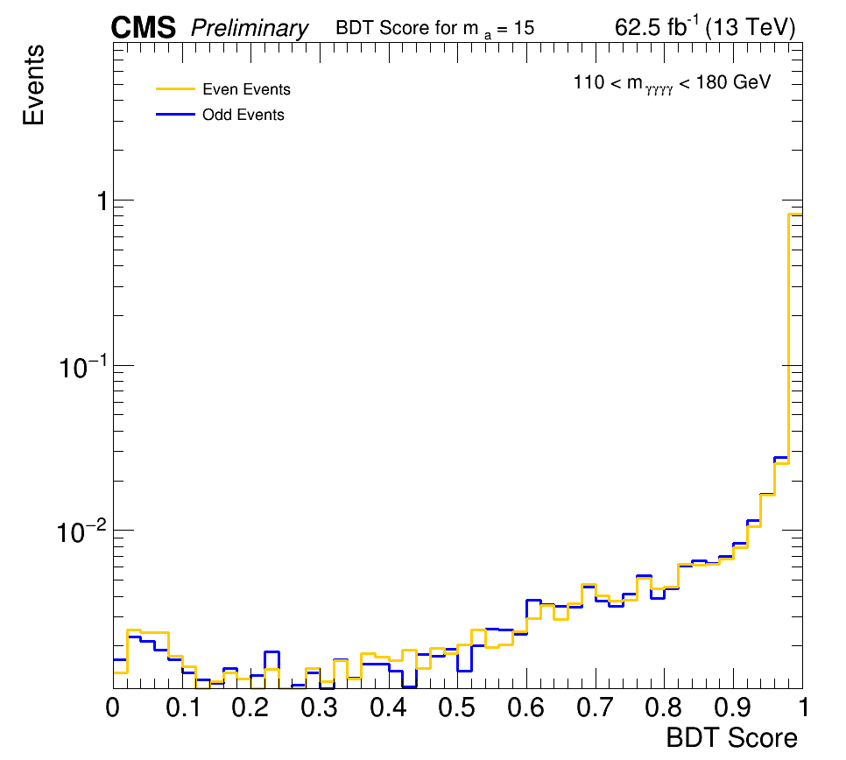
Checking the Event Selection BDT
Checks for overtraining are done to ensure an optimal event selection model is produced.
ROC checks can be done for the entire model at once and even/odd checks must be done by nominal mass point.
Above: ROC curve for one of the best event selection BDT models. A match between train/test curves and their associated area under curve (AUC) indicates a lack of overtraining.
Left: Overtraining check by comparing prediction distribution of trained event selection BDT model for m_{a} = 15 GeV. Odd/even (train/test) samples should have a similar distribution which would indicate a lack of overtraining.

Slide 39
BDT Score Categorization Details
Reminder: Approximate Mean Significance (AMS)
where S and B reference to the number of signal and background events, respectively.
The BDT score distributions for signal MC, event mixed background, and data are smoothed for each nominal mass point to account for statistical fluctuations when using very fine binning.
Category boundaries are optimized to maximize total AMS in the signal region while requiring at least 8 data events in the sideband region.
In the case of multiple categories, AMS is added in quadrature.
Cuts at category boundaries will be applied to all samples.

Slide 40
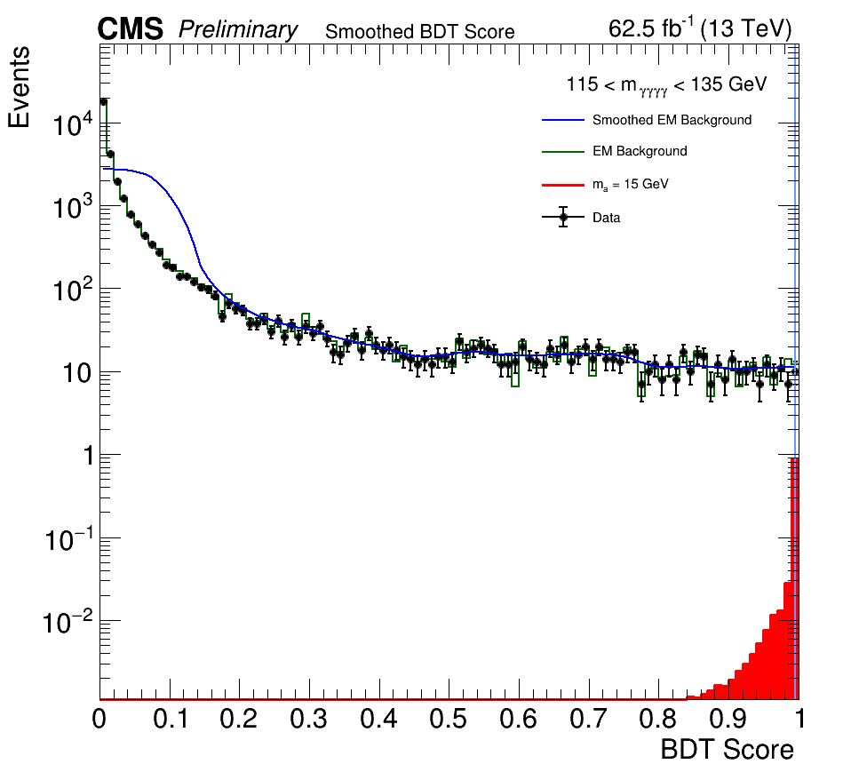
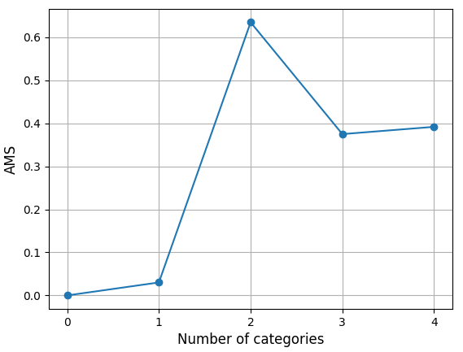
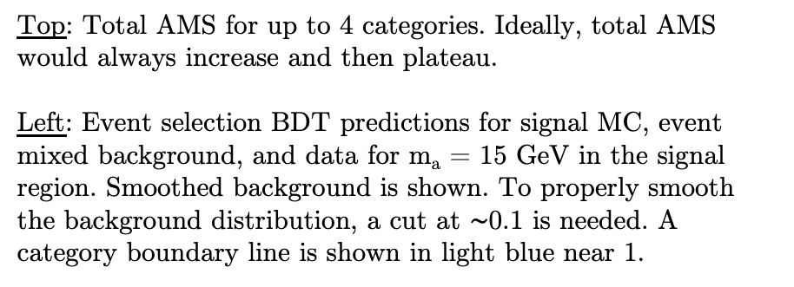
BDT Score Category Optimization
Top: Total AMS for up to 4 categories. Ideally, total AMS would always increase and then plateau.
Left: Event selection BDT predictions for signal MC, event mixed background, and data for m_{a} = 15 GeV in the signal region. Smoothed background is shown. To properly smooth the background distribution, a cut at $∼$0.1 is needed. A category boundary line is shown in light blue near 1.

